Slide 1
Iron Mountain Communities
Broadband Survey
Diane Kruse
dkruse@NEOconnect.us
970-309-3500

Slide 2
Surveys, Petitions
817 Responses, as of 10/10/2017
510 Petitions Signed

Slide 3
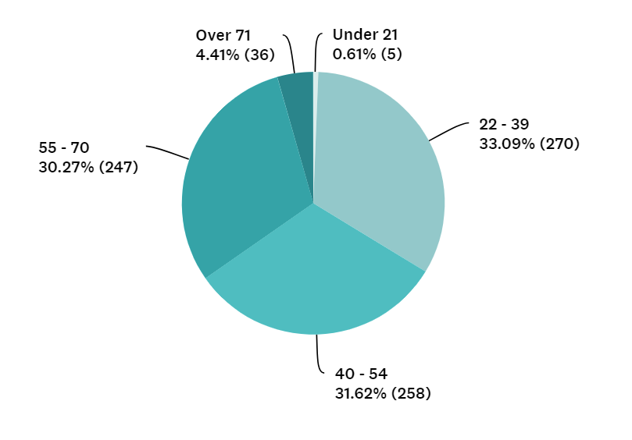
RESIDENTIAL DEMOGRAPHICS
Age. 33.09% of respondents are between the ages of 22 and 39 followed by respondents falling in the age range of 40-54 (31.62%).

Slide 4
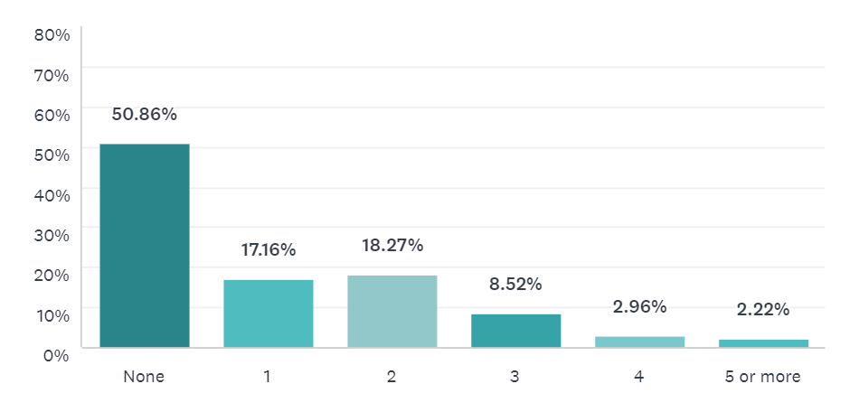
School-Aged Children Living at Home
How many people living at your home are in elementary, high school or attending college?

Slide 5
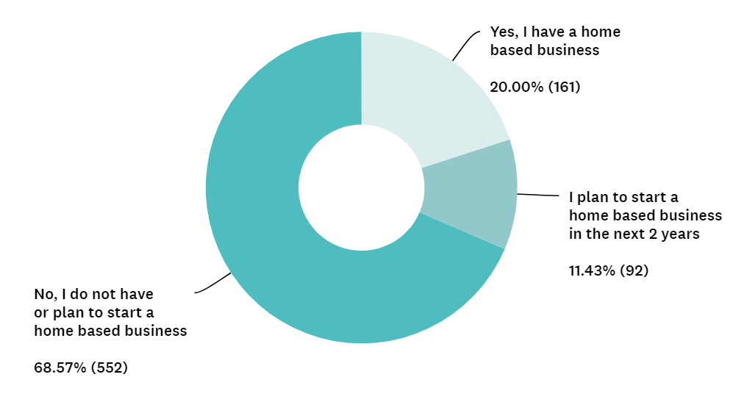
Home-Based Business

Slide 6
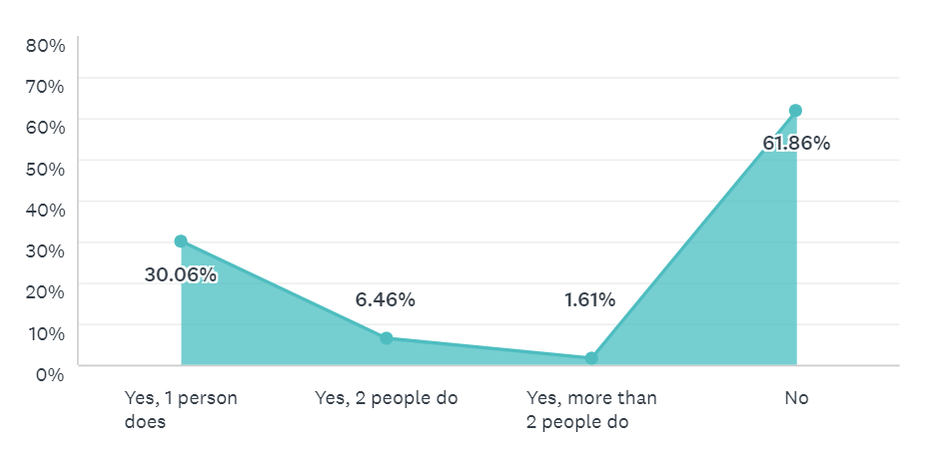
Telecommunting
39% have at least one person working from home

Slide 7
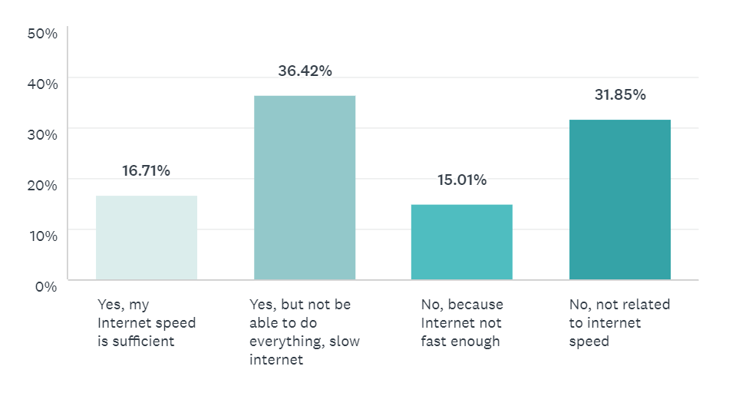
Telecommunting
36.77% would work from home but would not be able to do everything they needed to, due to slow internet

Slide 8
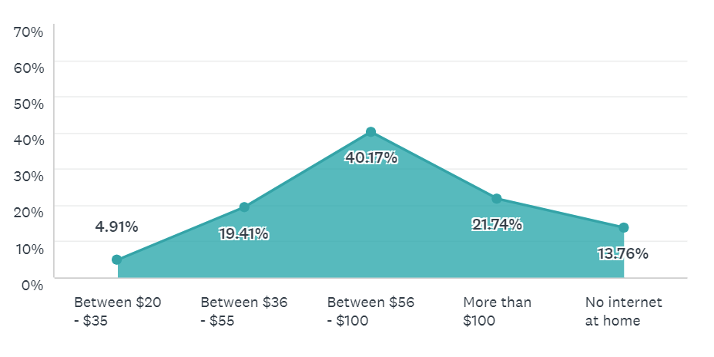
CURRENT PRICING
40% of respondents are paying between $56 - $100/month for their Internet service. Nearly 22% of households pay more than $100/month to obtain adequate service. A notable number of respondents, 13.76%, have no internet in the home.

Slide 9
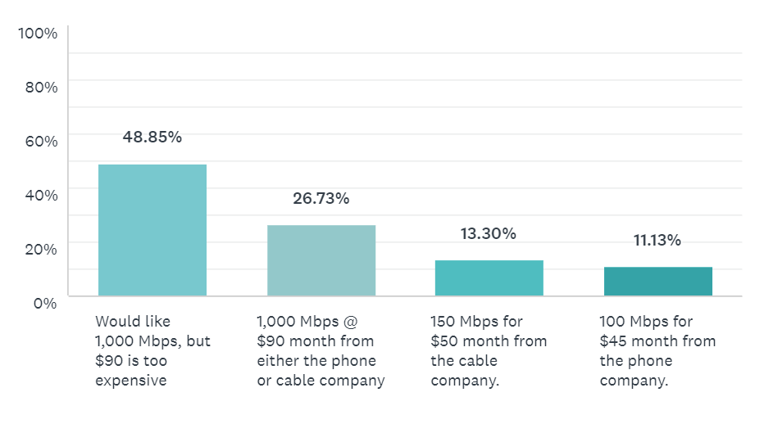
Which Options would you be more likely to choose?

Slide 10
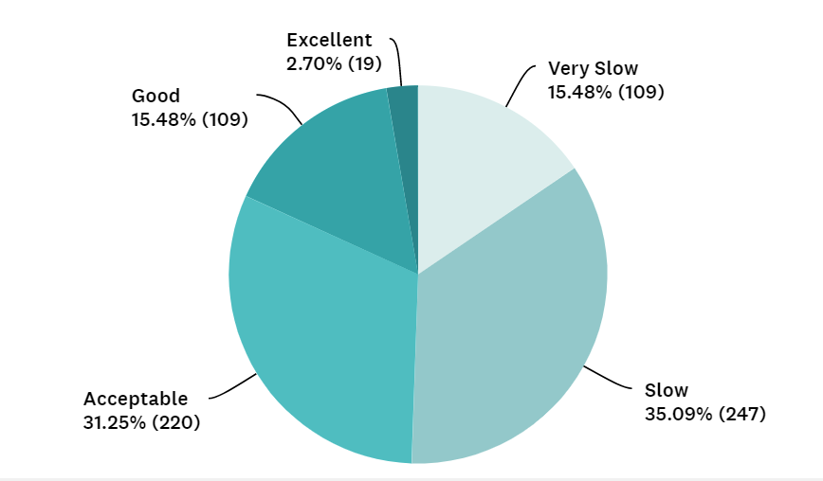
PERCEIVED SPEED
50.57% indicated that internet was “Very Slow” or “Slow”

Slide 11
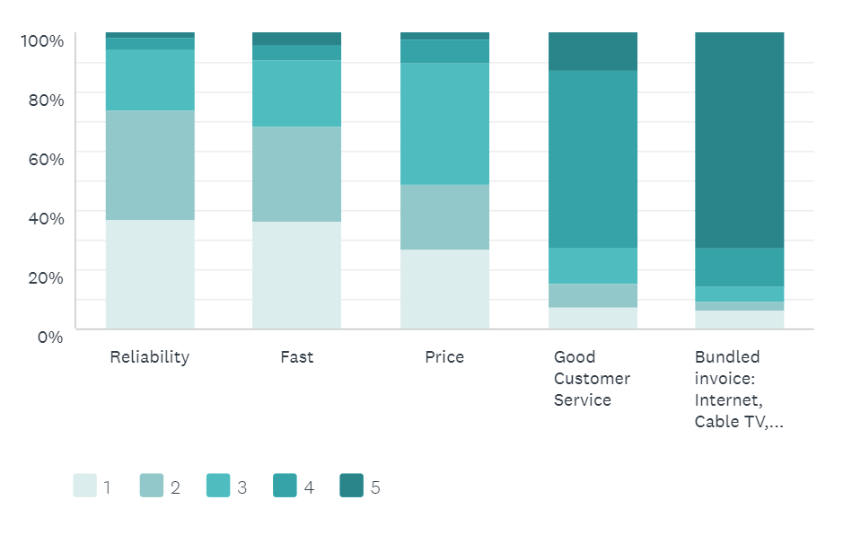
WHAT IS MOST IMPORTANT?
‘1’ being most important
1. Reliability 2. Speed. 3. Price

Slide 12
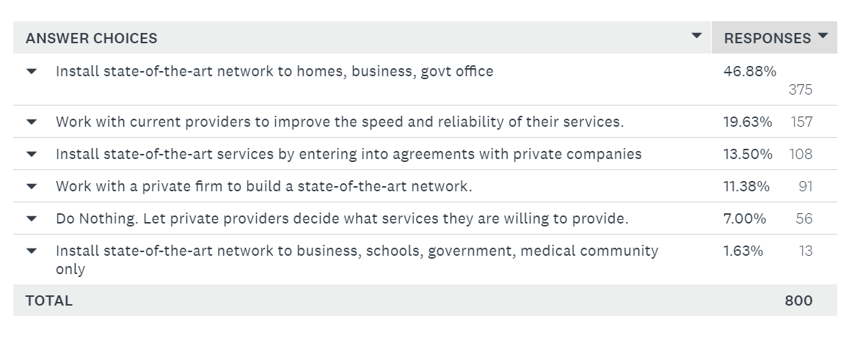
Role of Government
Respondents overwhelmingly want state-of-the-art internet services offered to the public, including homes, businesses and government offices
Notes:
The graph and the score is confusing…change this
Not a luxury, utility

Slide 13
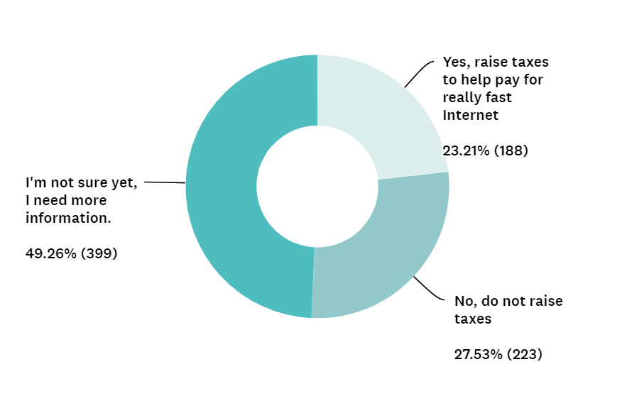
Tax Increase for Broadband
Most residents, 49.26% need more information before supporting a tax increase

Slide 14
Residential Survey Results
Community Statistics
What Matters?
51% of homes have school aged residents
20% have home-based business
38% of the homes have at least 1person telecommuting
Cost per month vs Speed
49% would like 1000 Mbps but $90 to much
27% would pay $90 for 1000 Mbps from phone or cable co.
13% would pay $50 for 150 Mbps from cable co.
51% rate current speed slow or very slow
Reliability, Speed, then Price
Broadband Tax Increase:
23% Yes 28% No
49% Need more info
Notes:
718 Residential Surveys
40 Business Survey
Speed: FCC definition
1,000 Mbps is the Gold Standard (1 Gigabit)

Slide 15
NEXT STEPS, and QUESTIONS
Diane Kruse, 970-309-3500
diane@NEOconnect.us

